Slide 1

MINI PROJECT
FOR
MANAGEMENT
SYSTEM
IN C LANGUAGE
BY: SHRIYA (RA2111026010345)
SAHASRA (RA2111026010337)
POOJASRI(RA2111026010333)

Slide 2
OUR PROJECT HAS BEEN CATAGORISED
INTO THREE PARTS:
LIBRARY MANAGEMENT SYSTEM
ATM BANKING SYSTEM
RESTAURANT BILLING SYSTEM

Slide 3
AIM
Library management is a project that maintains and stores book data electronically according to students’ needs. The system supports both students and library administrators to keep a consistent track of all the books available in the library.
ATM banking enables customers to access their accounts without visiting the bank. When a user requires to withdraw cash, they can enter their PIN number and the amount to be withdrawn.
A Restaurant Billing software eases billing operations by automation and improves the overall customer experience.

Slide 4
LIBRARY MANAGEMENT SYSTEM
Algorithm
Step 1: Declare a structure which holds data members
Step 2: declare variables which are used for loop
Step 3: use switch case to work on each module
Step 4: case 1- for Adding book information
Case 2- for Display book information
Case 3- for Display book of given Author
Case 4- for Finding number for books in library
Case 5- for EXIT

Slide 5
PROCEDURE
First we will declare the variables.
Printf() and scanf() functions for displaying the content and taking input from the user.
For entering the choice we use while loop.
Then we use switch case for entering user choice
Program uses structure to store books records.
In case 3 strcmp function is used to match author’s name.

Slide 6
module
void mainlibrary()
{
struct library lib[100];
char ar_nm[30], bk_nm[30];
int i, input, count;
i = input = count = 0;
while (input != 5) {
printf("\n\n*************"
"WELCOME TO E-LIBRARY "
"*************\n");
printf("\n\n1. Add book infor"
"mation\n2. Display "
"book information\n");
printf("3. List all books of "
"given author\n");
printf(
"4. List the count of book"
"s in the library\n");
printf("5. Exit");
printf("\n\nEnter one of "
"the above: ");
scanf("%d", &input);
switch (input) {
case 1:
printf("Enter Book Name = ");
scanf("%s", lib[i].book_name);

Slide 7
printf("Enter Author Name = ");
scanf("%s", lib[i].author);
printf("Enter Pages = ");
scanf("%d", &lib[i].pages);
printf("Enter Price = ");
scanf("%f", &lib[i].price);
count++;
break;
case 2:
printf("You have entered"
" the following "
"information\n");
for (i = 0; i < count; i++) {
printf("book name = %s",
lib[i].book_name);
printf("\t author name = %s",
lib[i].author);
printf("\t pages = %d",
lib[i].pages);
printf("\t price = %f",
lib[i].price);
}
break;
case 3:
printf("Enter Author Name : ");

Slide 8
if (strcmp(ar_nm,
lib[i].author)== 0)
{
printf("book name = %s",
lib[i].book_name);
printf("\t author name = %s",
lib[i].author);
printf("\t pages = %d",
lib[i].pages);
printf("\t price = %f",
lib[i].price);
}
}
break;
case 4:
printf("\n No of books in "
"library : %d",
count);
break;
case 5:
printf("\nTHANKYOU FOR USING E-LIBRARY:)");
}
}
}

Slide 9
ATM BANKING
ALGORITHM
Step 1: Declare variables and initialize with values.
Step 2: if the entered pin matches , use switch case to get following values
Step 3: case 1- for Withdrawal of money
Case 2- for Depositing the money
Case 3- to find the Balance money
Default- to EXIT

Slide 10
PROCEDURE
First we will declare the variables.
Printf() function is used for displaying the current time in the console
For entering the pin and to continue transaction, we use while loop.
Then we use switch case for entering user choice
The transaction can be carried out as many times by pressing ‘y’ and if not needed press ‘n’ and exit the loop.

Slide 11
module
void mainbankingsystem()
{ int pin=1234 , option ,
enteredPin , count=0 , amount=1;
float balance=5000;
int continueTransaction=1;
time_t now;
time(&now);
printf("\n");
printf ("\t\t\t\t\t %s",ctime(&now));
printf("\n\t\t\t
====================Welcome to ATM===================");
while(pin != enteredPin){
printf("\nPlease enter your pin : ");
scanf("%d",&enteredPin);
if(enteredPin !=pin){
Beep(610,320);
printf("Invalid pin!!!"); }
count++;
if(count==3 && enteredPin!=pin){
return 0;
}} while(continueTransaction !=0)
{printf("\n\t\t\t====================*Available Transactions================");

Slide 12
printf("\n\n\t\t1.Withdrawal");
printf("\n\t\t2.Deposit");
printf("\n\t\t3.Check Balance");
printf("\n\n\tPlease select an option : ");
scanf("%d",&option);
switch(option){
case 1: while(amount % 500 !=0){
printf("\n\t\tEnter the amount :");
scanf("%d",&amount);
if(amount % 500 !=0)
printf("\n\tThe amount must be multiples of 500"); }
if(balance < amount){
printf("\n\t Sorry insufficient balance"); amount=1;
break; }
else{
balance -=amount;
printf("\n\t\tYou have withdrawn Rs.%d your new balance is Rs.%f",amount,balance);
amount=1;
break; }

Slide 13
case 2;
printf("\n\t\t Please enter the amount : ");
scanf("%d",&amount);
balance+=amount;
printf("\n\t\t You have deposited Rs.%d your new balance is Rs.%f",amount,balance);
amount=1;
break;
case 3:
printf("\n\t\t Your balance is Rs.%f",balance);
break;
default:
Beep(610,320);
printf("\n\t\t Invalid option!!");}
printf("\n\n\t\t Do you wish to perform another Transaction? press 1[yes],0[no]");
scanf("%d",&continueTransaction);
}
printf("\n\t\t Thank you for banking\n");
}

Slide 14
RESTAURANT MANAGEMENT SYSTEM
ALGORITHM
Step 1: Declare variables and their values
Step 2: We used void printmeals and void ordermeals to print the menu and order.
Step 3: We used while loop for the following values
1) Please enter your option
2) Please enter your amount of order
3) would you like to enter more orders.

Slide 15
PROCEDURE
First we will declare the variables.
Printf() and scanf() functions are used to display the menu and also take input from the user
We used while loop for entering the choice
We have entered the required calculations for the total bill and discounts respectively.
After the final billing we can press y or n to continue or exit the loop respectively.

Slide 16
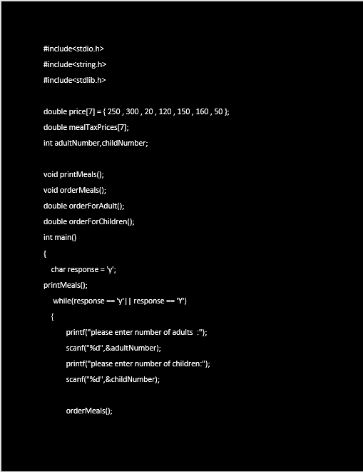
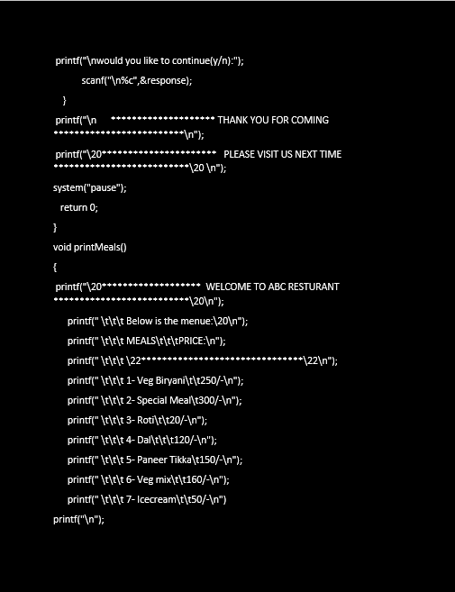
module

Slide 17
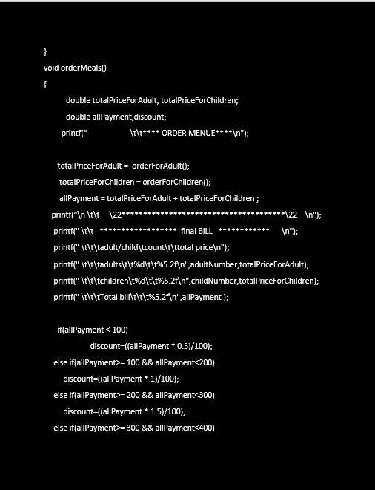
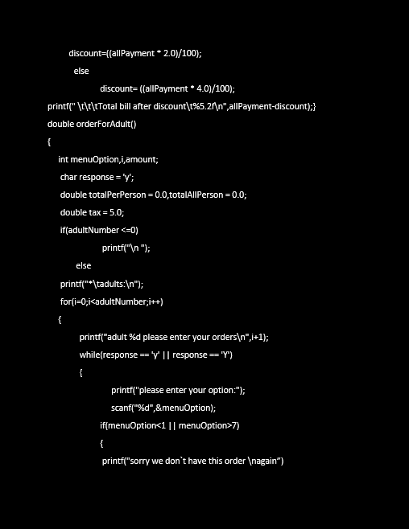

Slide 18
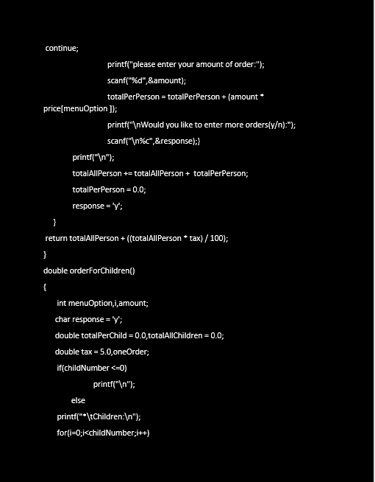
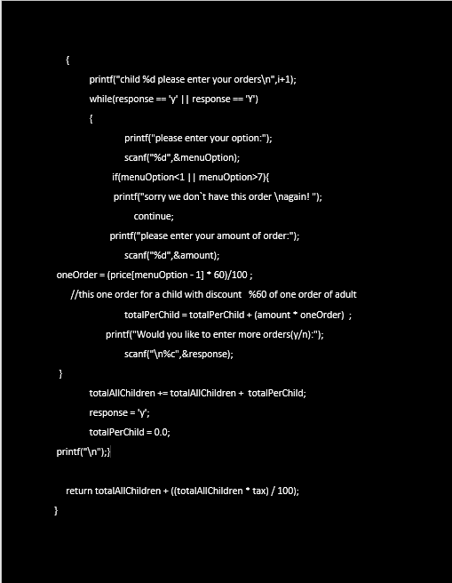

Slide 19
Advantages
The data should be stored in computer rather than in register manually.
Better planning and build an application program to reduce the manual work for managing the tasks.
It has faster access to the stored data.
Userfriendly.
Time saving.

Slide 20
Link for whole code:
https://github.com/Shriyaa04/MINI-PROJECT/blob/main/main.c

Slide 21
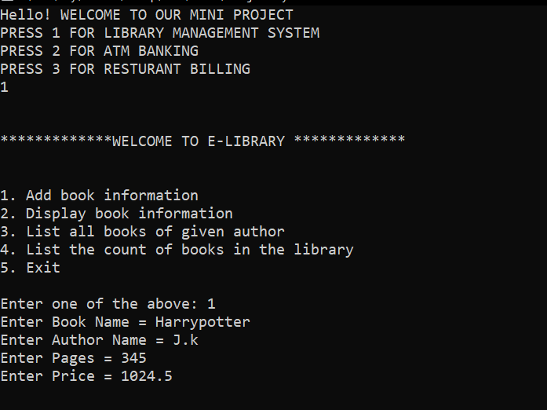
Output

Slide 22
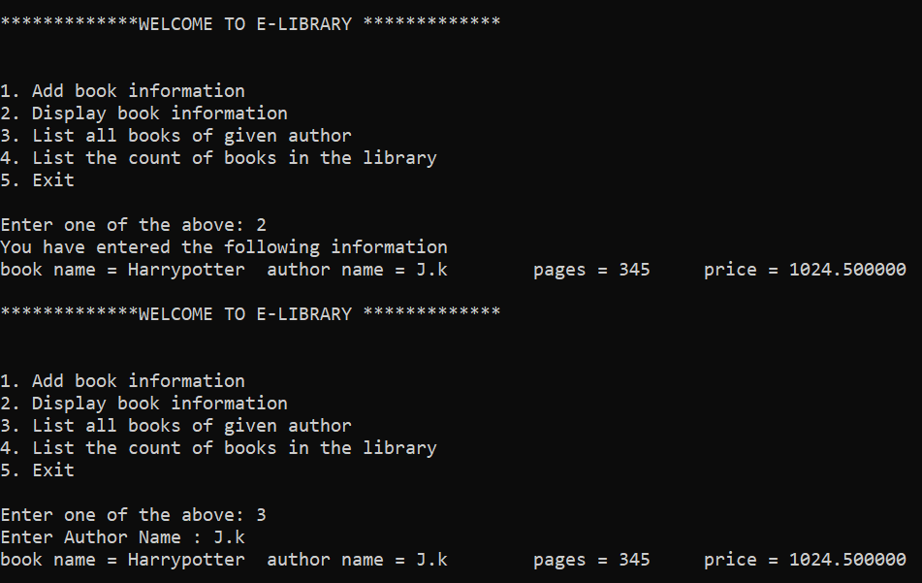

Slide 23
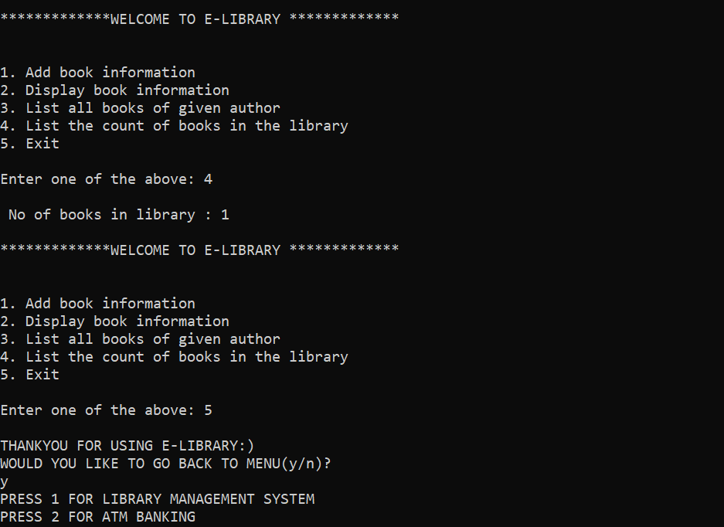

Slide 24
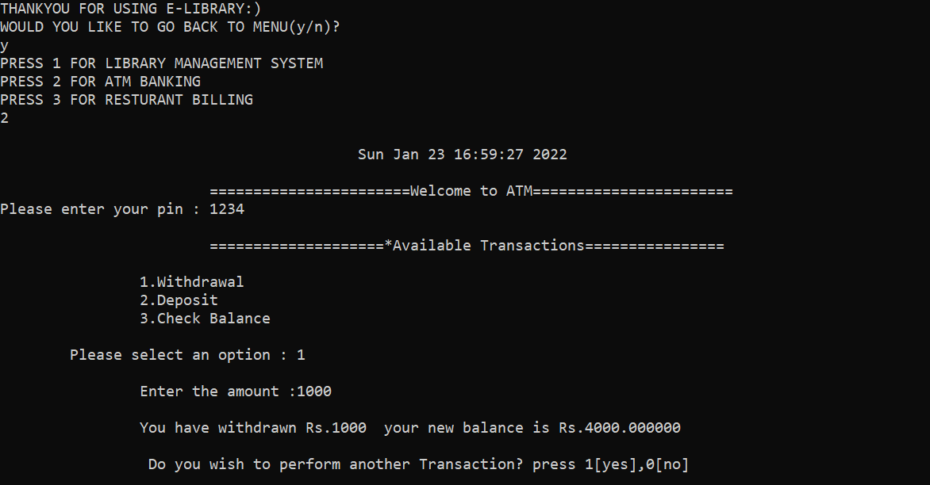

Slide 25
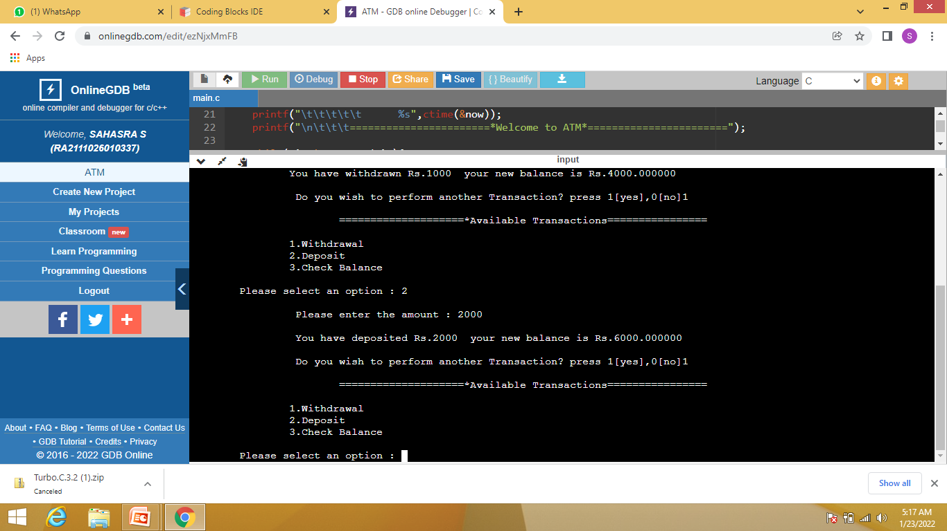

Slide 26
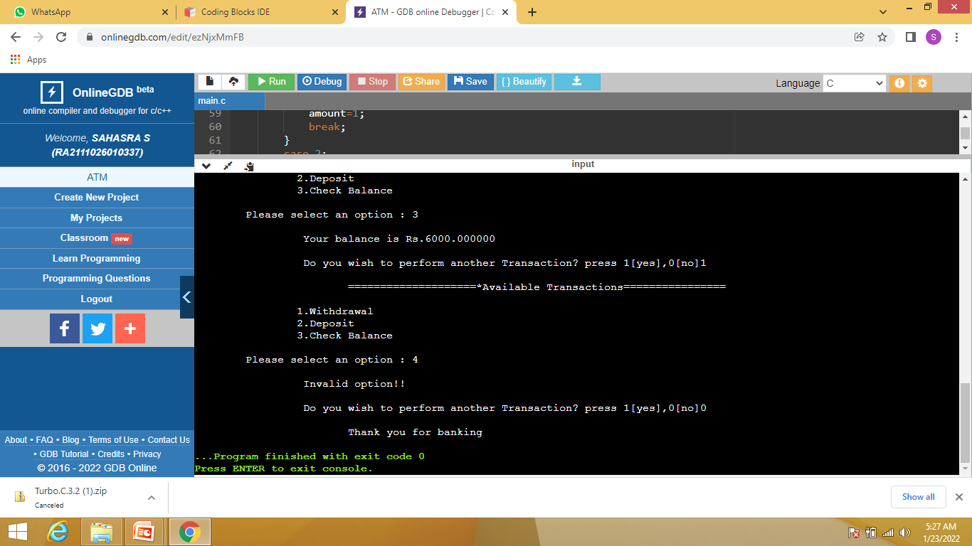

Slide 27
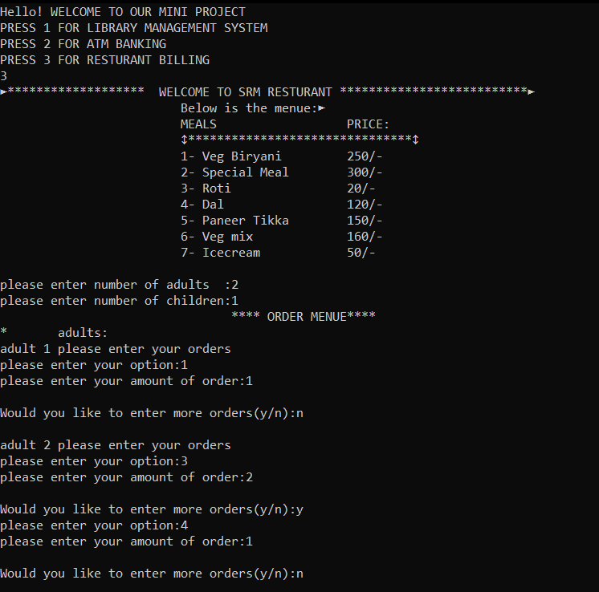

Slide 28
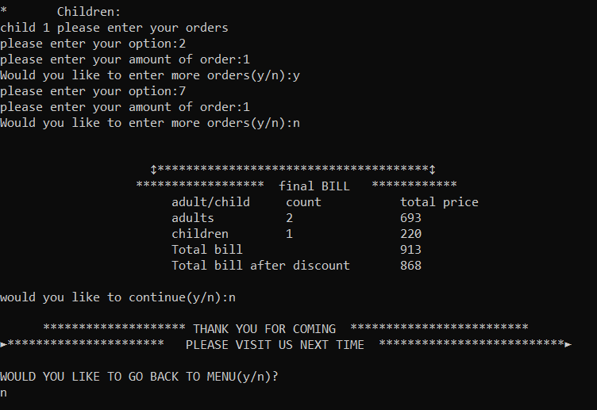

Slide 29


